Slide 1

WEBSITE OF LAW FIRM MANAGEMENT SYSTEM
CAPSTONE PROJECT

Slide 2
SUPERVISOR:
TEAM MEMBERS:
NGUYEN VAN SANG
LE DUY HOANG
DANG NGUYEN KHIEM
TRAN ANH TUAN
PHAM VAN DUY

Slide 3

CONTENTS
REQUIREMENT
CORE FLOW
01 REQUIREMENT
02 PROBLEM
03 SOLUTION
04 PROJECT
05 CORE FLOW
PROJECT
PROBLEM
SOLUTION

Slide 4

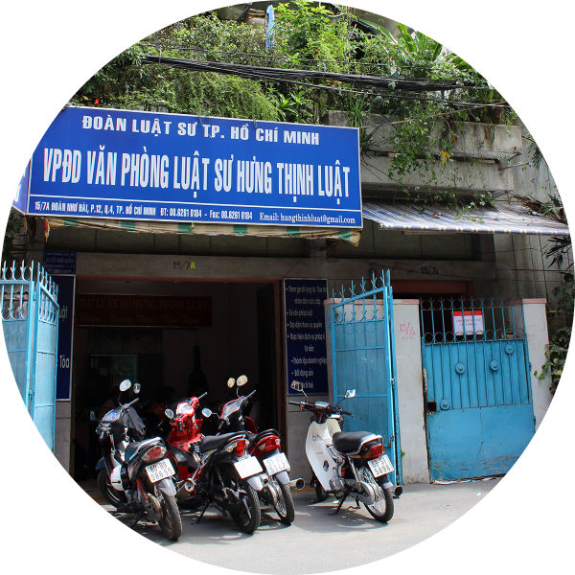
REQUIREMENT
This project get requirements from "Thuan Nguyen Lawyer Office" in Vinh Long City. The majority of this project is to use internal systems used to manage Office, Service, Staff, Customer, Case Management, Consulting, Contract and Reports…
Existing solution is to go for the actual project, met the manager of law office, Mr. Thuan. And then get actual requirements for project.
Manager of

Slide 5
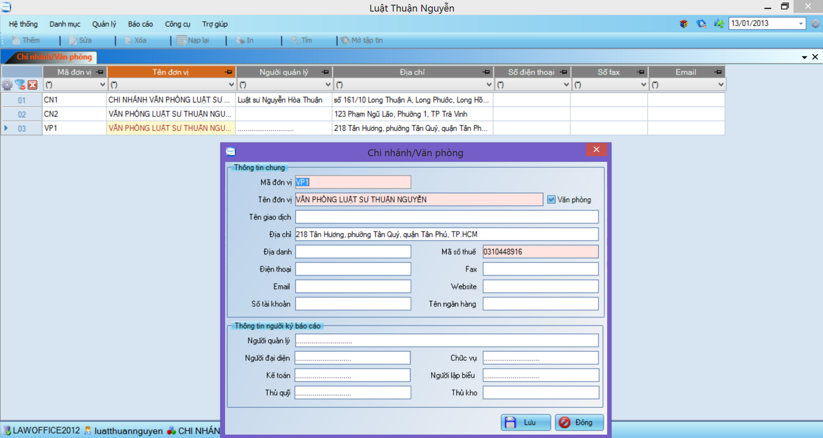
PROBLEM / Current System

Slide 6





PROBLEM / Current System
Many errors occur
Difficult to upgrade or maintain
Limit number of devices can use
Manage only 1 office
Manage with only text information

Slide 7

SOLUTION / LFMS
Steady running
Easy upgrade and maintenance
Multiple devices can use at the same time
Can be used for many types of office
Manage multimedia data

Slide 8









PROJECT / Tools and Techniques

Slide 9
PROJECT / MVC Architectural Design

Slide 10


PROJECT / Future Plan
Use Android App
To Locate by GPS

Slide 11
PROJECT / User Role
Admin
Creator
Viewer

Slide 12
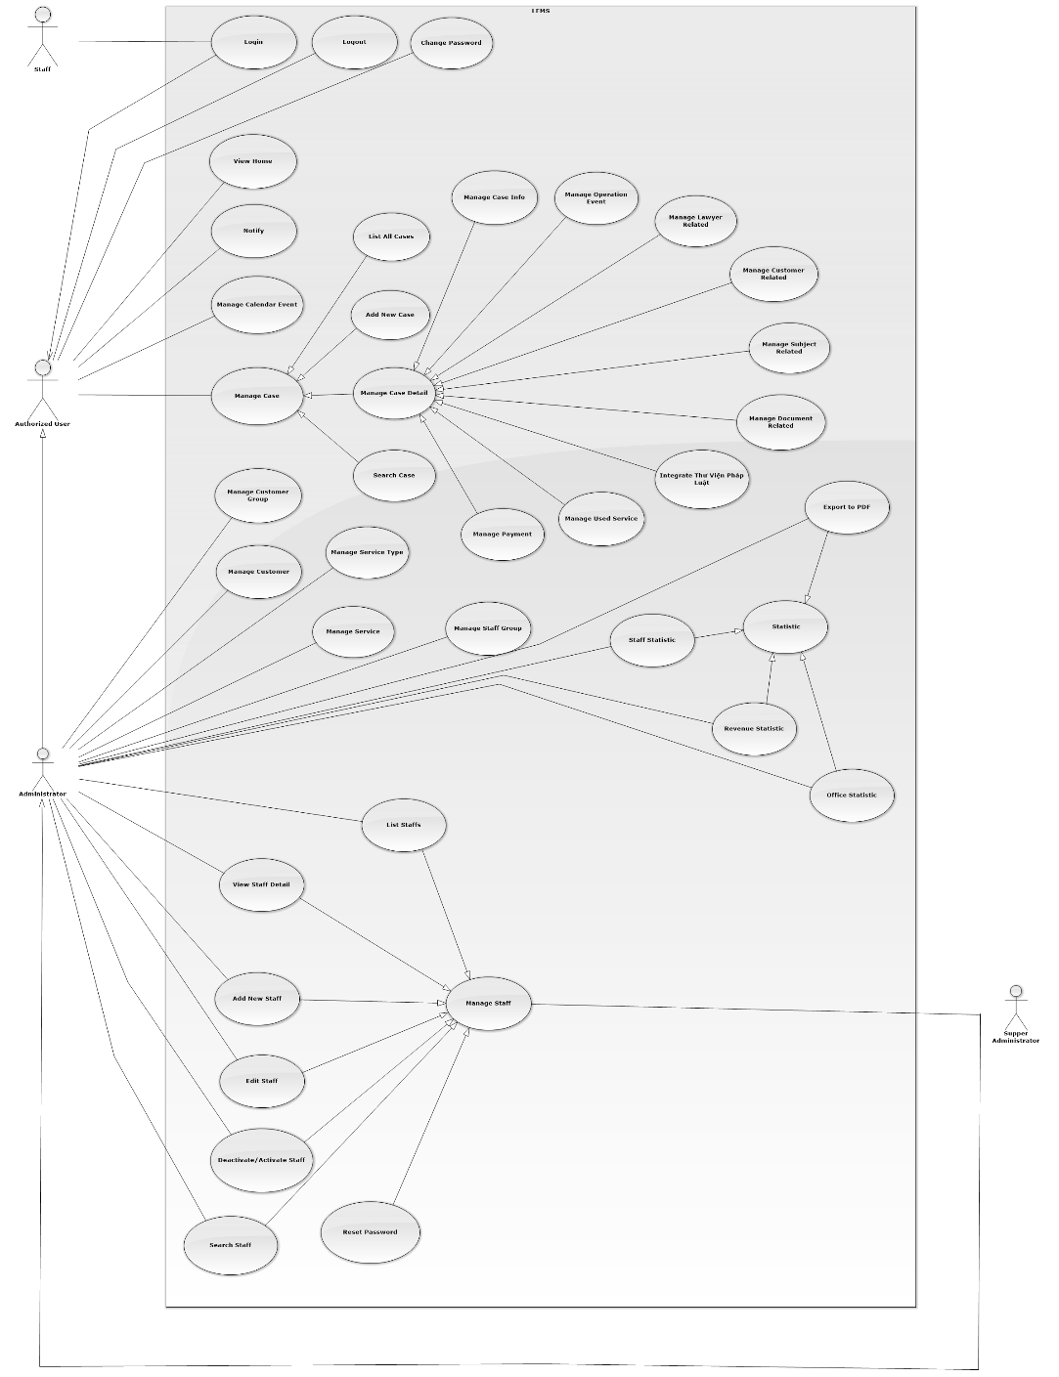
PROJECT / Functional Requirement
Use case diagram

Slide 13
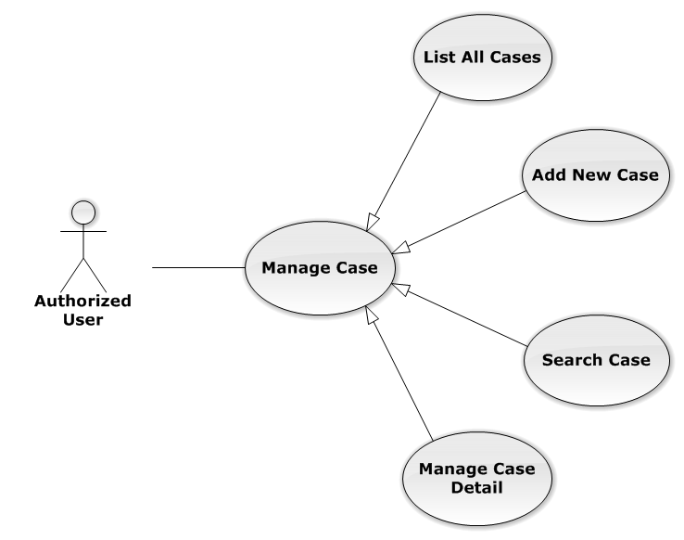
PROJECT / Functional Requirement
Manage case function for web are used by authorized user.
Management case on Database: List, add new, search and manage case detail.

Slide 14
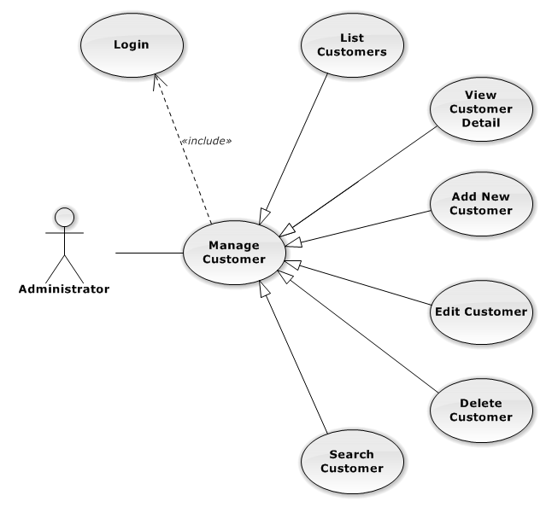
PROJECT / Functional Requirement
Manage customer function for web are used by Administrator user.
Management customer on Database: List, view, add new, edit, delete and search customer.

Slide 15
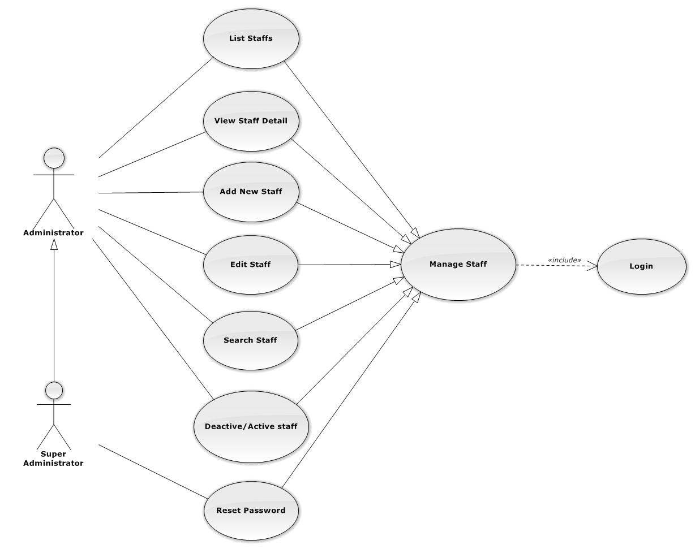
PROJECT / Functional Requirement
Manage staff function for web are used by Administrator and super administrator.
Management staff on Database: List, view, add new, edit, search and deactivate/active staff.

Slide 16
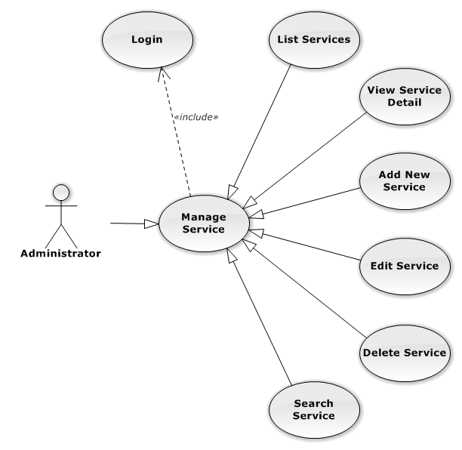
PROJECT / Functional Requirement
Manage service function for web are used by Administrator.
Management service on Database: List, view, add new, edit, delete and search service.

Slide 17
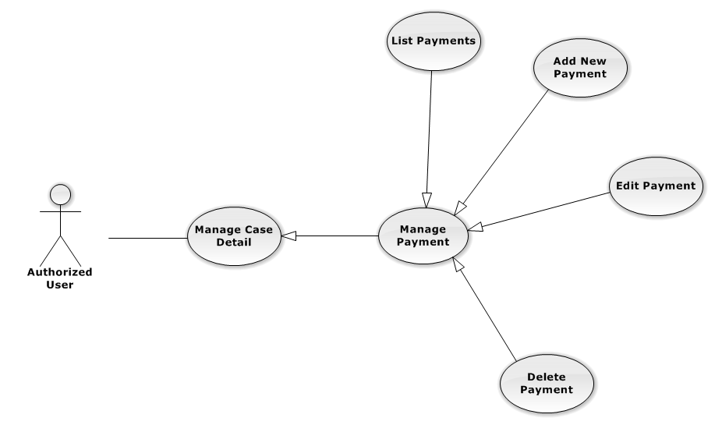
PROJECT / Functional Requirement
Manage payment function for web are used by Authorized user.
Management payment on Database: List, add new, edit, and delete payment.

Slide 18
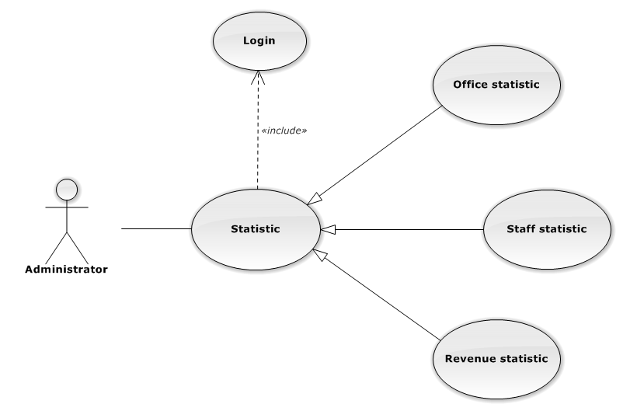
PROJECT / Functional Requirement
Manage statistic function for web are used by Administrator user.
Management statistic on Database: Office statistic, Staff and revenue statistic.

Slide 19
PROJECT / Non- Functional Requirement
Reliability:
The systems with high reliability, can be used like “always on” system.
However, if exist accident, it's not need require immediate repair. All information can be updated later.
Availability:
The system always responds to every user who got permission.
The expected downtime for maintenance is about 5 minutes each time.
Security:
Users must login for using the system. The user passwords are MD5 encrypted before being put into
Database. Staff are restricted to view other user’s information and any function. Super Administrator has
full permission to use the system.
Maintainability:
Each component only perform specific functions so the modification of a component will not affect
other components.
Portability:
The system can be accessed anywhere with a web browser and Internet connection.
It can be run on any browser, but recommend for user is Mozilla Firefox with highest version.
Performance:
Time to response, time of processing.

Slide 20
Core Flow
Add New Case
Assign Lawyer
Update Case Detail

Slide 21
LFMS
Thank You !

